Slide 1


UNIVERSITY INSTITUTE OF TECHNOLOGY, BARKATULLA UNIVERSITY, BHOPAL
MAJOR PROJECT
DEEPFAKE IMAGE DETECTION
Presented by: Aryan Singh
Vinayak Modi
Ankit Patil
Submitted To: Dr. Kamini Maheshwar
Mrs. Kavita Chourasia

Slide 2
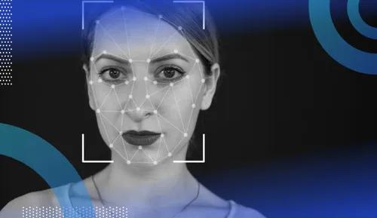

DEEPFAKE
IMAGE DETECTION
Presented by: Aryan Singh
Vinayak Modi
Ankit Patil

Slide 3
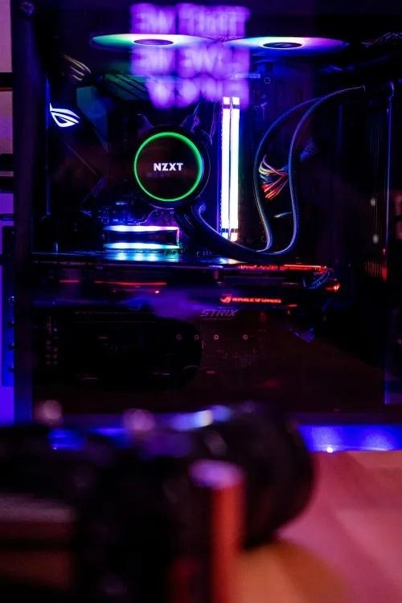
OVERVIEW
01
02
03
Introduction
Models
Technology Used
04
05
06
Working
Impact
Future Scope

Slide 4





INTRODUCTION
WHAT?
SOLVE!
Synthetic media created using AI.
Challenge authenticity and trust.
Detection models evolving.
Future trends: blockchain, social networks, research collaboration. 🌐🔍
Synthetic media creations, often involving manipulated images or videos, have the potential to spread misinformation, damage reputations, and disrupt trust in online communication.

Slide 5





MODELS
01
FaceForensics is a supervised model that uses a convolutional neural network (CNN) to detect deepfakes.
02
Mesmer is a supervised model that uses a CNN and a long short-term memory (LSTM) network to detect deepfakes.
03
DFVideo++ is an unsupervised model that uses an LSTM network to detect deepfakes. Strategies for Ending Deepfakes

Slide 6




TECHNOLOGY
01
TensorFlow is the core library for building and training machine learning models.
02
Keras (from tensorflow.keras) is a high-level API built on top of TensorFlow, simplifying model building
03
Layers (from tensorflow.keras.layers) provides building blocks for creating neural network layers.
04
Xception (from tensorflow.keras.applications) is a pre-trained image classification model used as a starting point for this deepfake detection model.

Slide 7
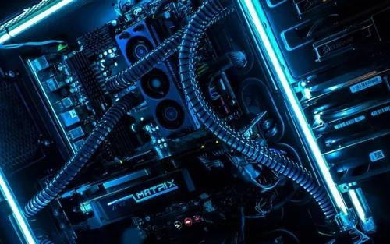
WORKING OF DEEPFAKE
Flow Chart
Input image
Preprocessing
Training Set
(80%)
Training Set
(20%)
Training SAE-GLSTM to extract the temporal features from frames
Training capsuled dual graph CNN for detection
Prediction of Image
Real Image
Fake Image

Slide 8



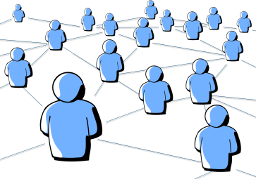

TYPES OF DEEPFAKE FRAUDS
Textual
Video
Audio
Social Media
Live

Slide 9

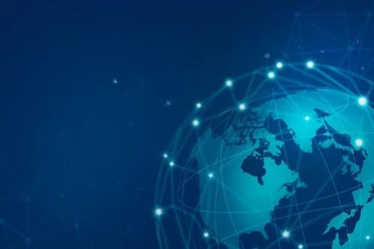
ADVANTAGES
•Accuracy: Deepfake detection models are becoming increasingly accurate, with some models achieving over 99% accuracy on benchmark datasets.
•Scalability: Deepfake detection models can be scaled to process large volumes of data, making them suitable for use in real-world applications.
•Generalizability: Deepfake detection models can be generalized to detect deepfakes created using a variety of different techniques.
•Efficiency: Deepfake detection models can be made efficient, so that they can be used on devices with limited compute resources.

Slide 10
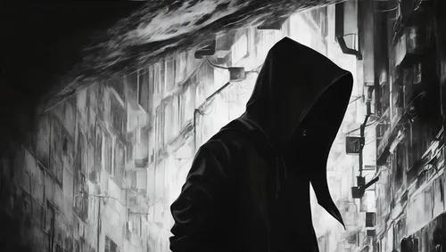
DISADVANTAGES
•Accuracy and Bias: False Positives and False Negatives: Deepfake detection models, like any machine learning model, are not perfect and can make mistakes.
•Bias and Fairness: Deepfake detection models can be biased, reflecting the biases present in the data they are trained on. For instance, if the training data primarily consists of deepfakes of a specific demographic group, the model may be less accurate at detecting deepfakes of other groups.
•Data Privacy Concerns: Training deepfake detection models requires large amounts of data, including real and fake images and videos.
•Adversarial Attacks: Deepfake detection models are susceptible to adversarial attacks, where attackers intentionally manipulate the inputs to fool the model into making a false classification.

Slide 11

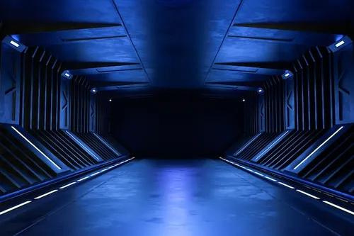




FUTURE SCOPE
NEWS & Social Media
•Detect and remove deepfakes from social media platforms to prevent the spread of misinformation.
•Verify the authenticity of news footage and images to prevent the spread of false information.
Finance & Insurance
•Detect deepfakes used in fraudulent activities, such as fake identity documents or deepfake videos used to blackmail individuals or companies.
Law Enforcement & Education
•Investigate potential crimes involving deepfakes, such as revenge porn or deepfake videos used to extort money.
•Teach students about deepfakes and how to identify them, in order to become more critical consumers of online media.

Slide 12

CONCLUSION
Deepfake image and video detection models are essential tools in combating the spread of misinformation and maintaining trust in digital media. By employing end-to-end technologies and novel approaches, these models can be developed and deployed effectively for mid-complexity projects, enabling accurate detection and mitigation of deepfakes.
Deepfakes are a serious threat, but there are a number of things that can be done to end them. By developing better detection models, raising awareness, and developing legislation, we can make it more difficult for deepfakes to be created and distributed.

Slide 13






OUR TEAM
Aryan Singh
Vinayak Modi
Ankit Patil

Slide 14
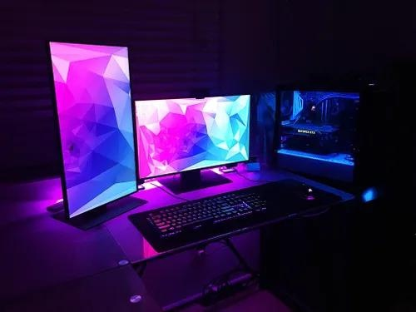
Thank's For Watching
Be up to date for better tommorow

